Slide 1


Fresh Rating Systems: Structure, Incentives, and Fees
Titing Cui^{1,2}, Michael L. Hamilton²
¹Collins School of Business, University of Tulsa
²Katz Graduate School of Business, University of Pittsburgh

Slide 2
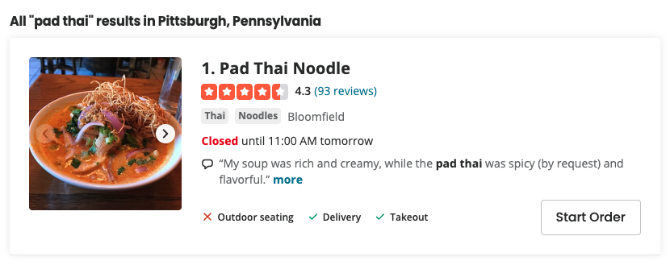
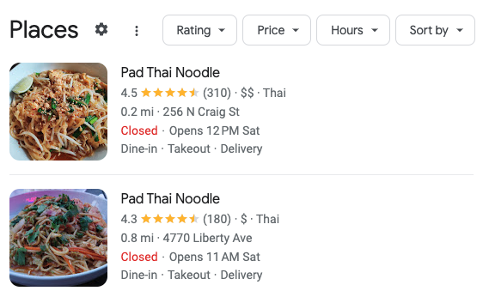
Rating Systems in Practice
Def: A Rating System aggregates reviews into a single, numeric measure of service provider quality.
Facilitates trust between a service provider and customer ^{[1]}
88% of customers investigate reviews before purchasing ^{[3]}
Many online platforms use a simple weighted average to aggregate reviews into ratings.
Google Reviews, Yelp ^{[2]}
Key issue: Staling
Ex 1.: Pad Thai near me from Yelp.com
Ex 2.: Pad Thai near me from Google Reviews
[1] S. Taledis, 2016. Reputation and Feedback Systems in Online Platform Markets.
[2] Mahfuze. 2023. Optimal Design of Ratings History
[3] https://www.powerreviews.com/insights/information-shoppers-want-product-reviews/
[4] M. Luca, 2017. Designing Online Marketplaces: Trust and Reputation Mechanisms
Notes:
“backbone of the online platforms”

Slide 3
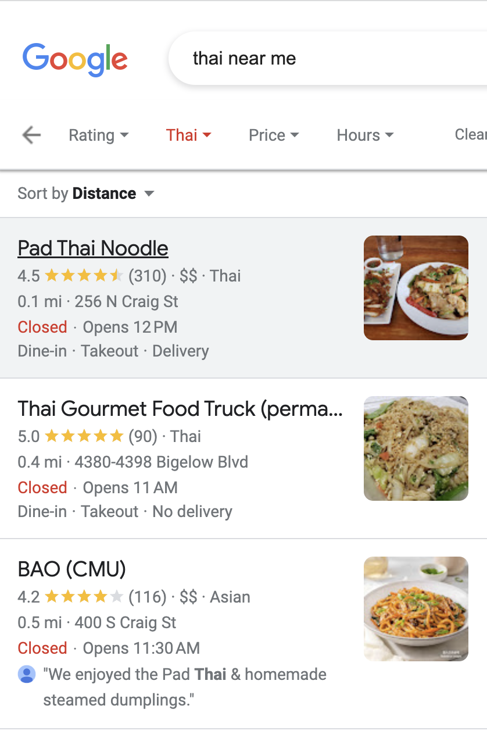
Rating Systems in Practice: Stale Ratings
Def: A Rating System aggregates reviews into a single, numeric measure of service provider quality.
Facilitates trust between a service provider and customer ^{[1]}
88% of customers investigate reviews before purchasing ^{[3]}
Def: We call a rating stale if it’s based off old transactions
38% of shoppers won’t purchase a product if the only reviews available are older than 90 days ^{[3]}
Key issue: Staling
Sequential Staling: Rating not determined by recent reviews
Ex.: Google reviews summary for Pad Thai Noodle
[1] S. Taledis, 2016. Reputation and Feedback Systems in Online Platform Markets.
[3] https://www.powerreviews.com/insights/information-shoppers-want-product-reviews/
[4] M. Luca, 2017. Designing Online Marketplaces: Trust and Reputation Mechanisms

Slide 4
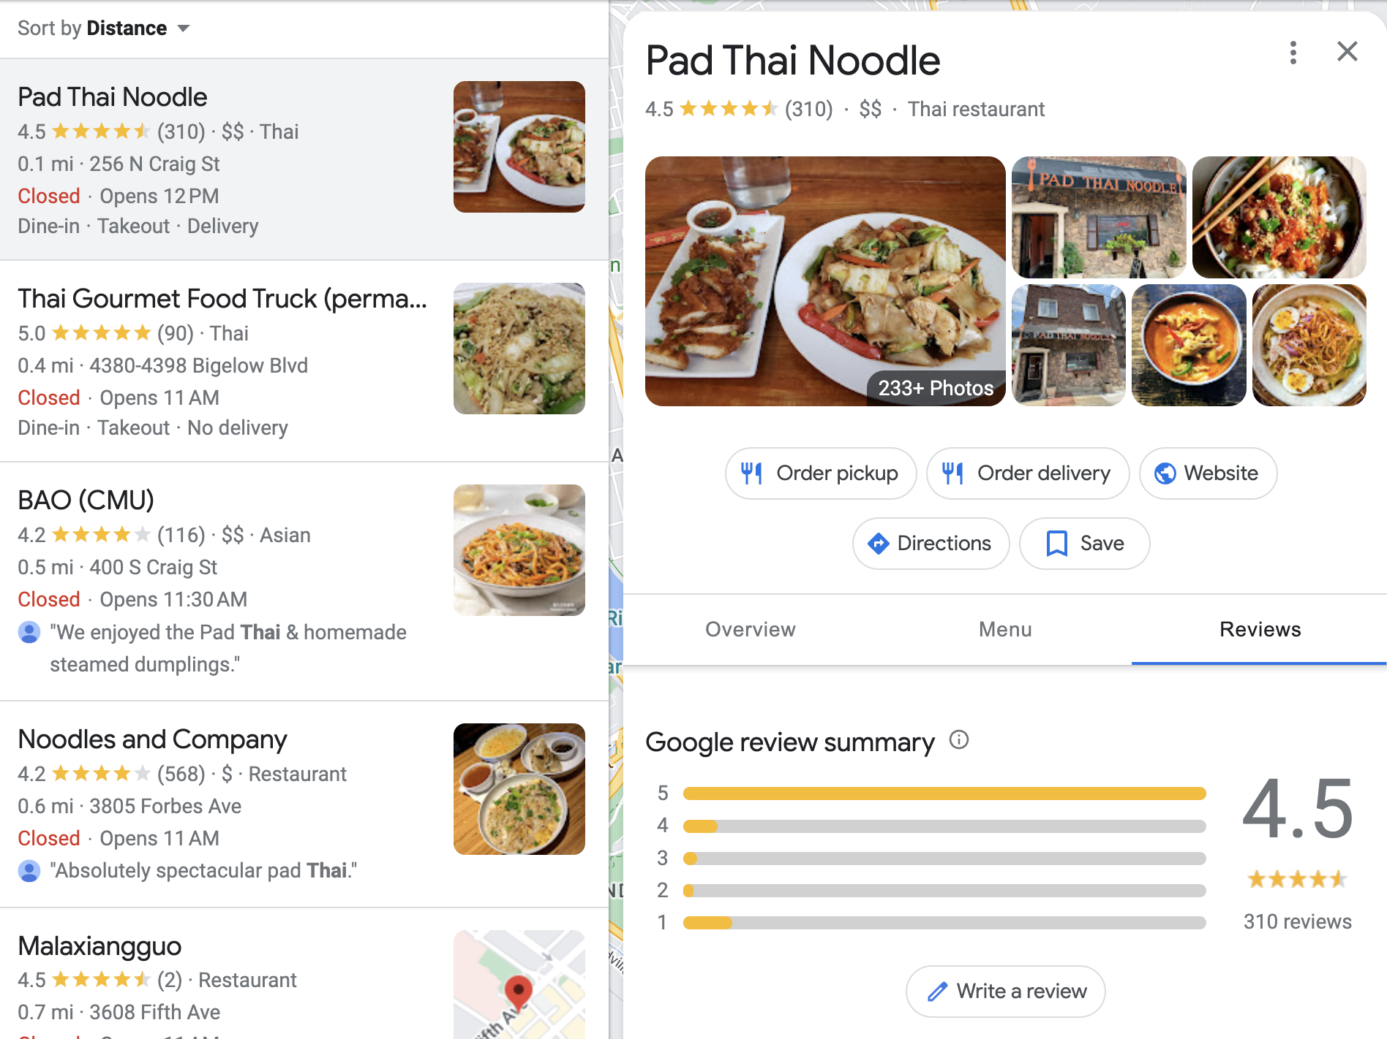
Rating Systems in Practice: Stale Ratings
Def: A Rating System aggregates reviews into a single, numeric measure of service provider quality.
Facilitates trust between a service provider and customer ^{[1]}
88% of customers investigate reviews before purchasing ^{[3]}
Def: We call a rating stale if it’s based off old transactions
38% of shoppers won’t purchase a product if the only reviews available are older than 90 days ^{[3]}
Key issue: Staling
Sequential Staling: Rating not determined by recent reviews
Ex.: Google review summary for Pad Thai Noodle
[1] S. Taledis, 2016. Reputation and Feedback Systems in Online Platform Markets.
[3] https://www.powerreviews.com/insights/information-shoppers-want-product-reviews/
[4] M. Luca, 2017. Designing Online Marketplaces: Trust and Reputation Mechanisms

Slide 5
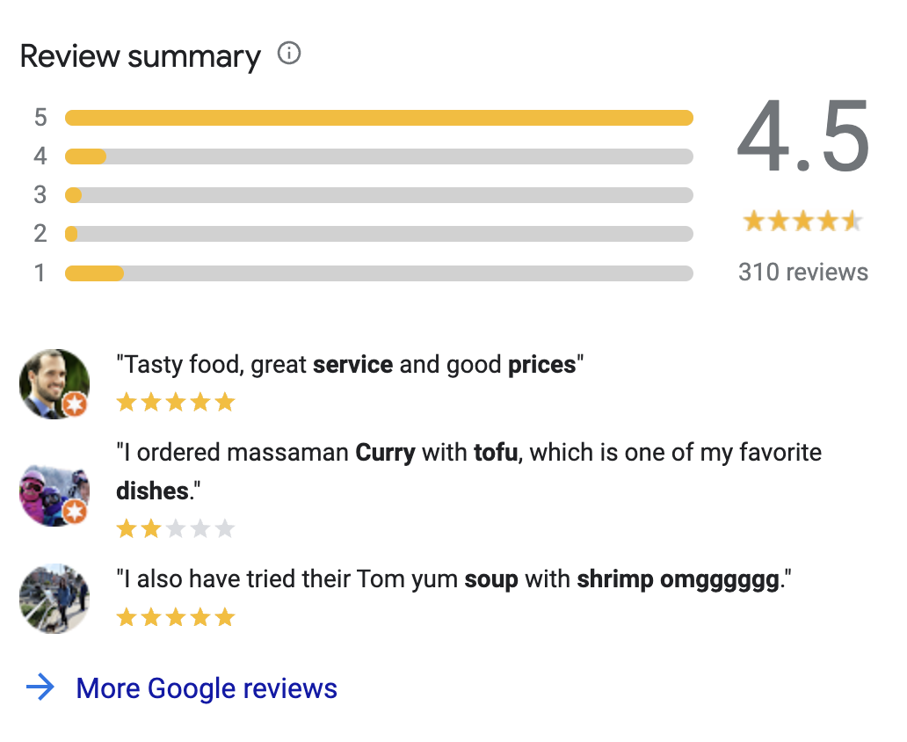
Rating Systems in Practice: Stale Ratings
Def: A Rating System aggregates reviews into a single, numeric measure of service provider quality.
Facilitates trust between a service provider and customer ^{[1]}
88% of customers investigate reviews before purchasing ^{[3]}
Def: We call a rating stale if it’s based off old transactions
38% of shoppers won’t purchase a product if the only reviews available are older than 90 days ^{[3]}
Key issue: Staling
Sequential Staling: Rating not determined by recent reviews
Ex.: Google review summary for Pad Thai Noodle
[1] S. Taledis, 2016. Reputation and Feedback Systems in Online Platform Markets.
[3] https://www.powerreviews.com/insights/information-shoppers-want-product-reviews/
[4] M. Luca, 2017. Designing Online Marketplaces: Trust and Reputation Mechanisms

Slide 6
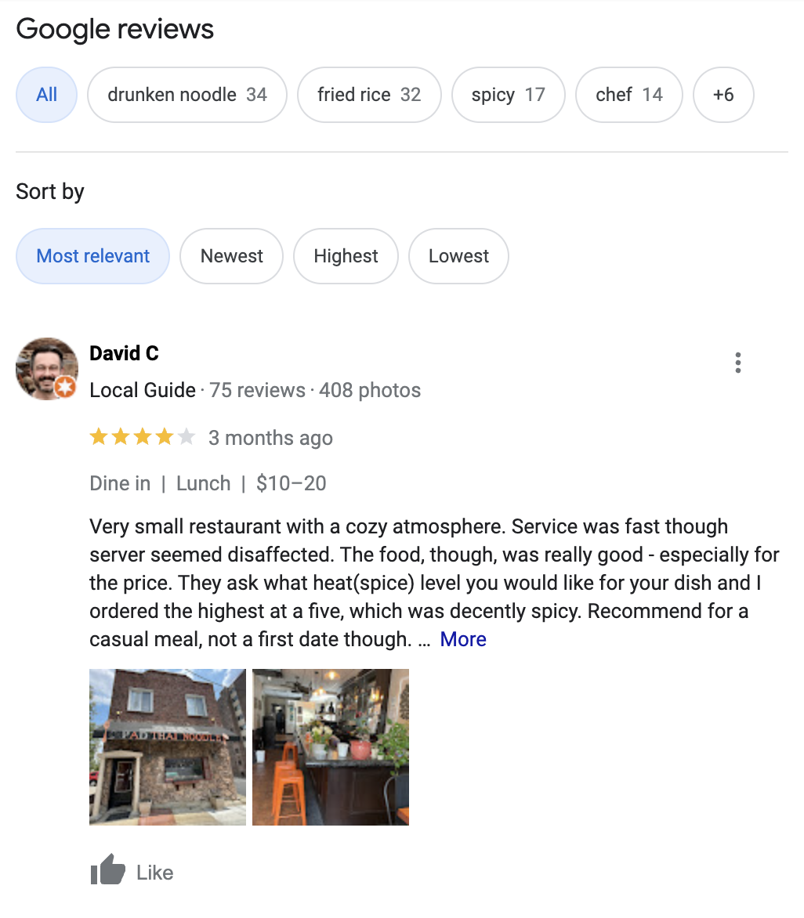
Rating Systems in Practice: Stale Ratings
Def: A Rating System aggregates reviews into a single, numeric measure of service provider quality.
Facilitates trust between a service provider and customer ^{[1]}
88% of customers investigate reviews before purchasing ^{[3]}
Def: We call a rating stale if it’s based off old transactions
38% of shoppers won’t purchase a product if the only reviews available are older than 90 days ^{[3]}
Key issue: Staling
Sequential Staling: Rating not determined by recent reviews
Ex.: Reviews seem good at first glance…
[1] S. Taledis, 2016. Reputation and Feedback Systems in Online Platform Markets.
[3] https://www.powerreviews.com/insights/information-shoppers-want-product-reviews/
[4] M. Luca, 2017. Designing Online Marketplaces: Trust and Reputation Mechanisms

Slide 7
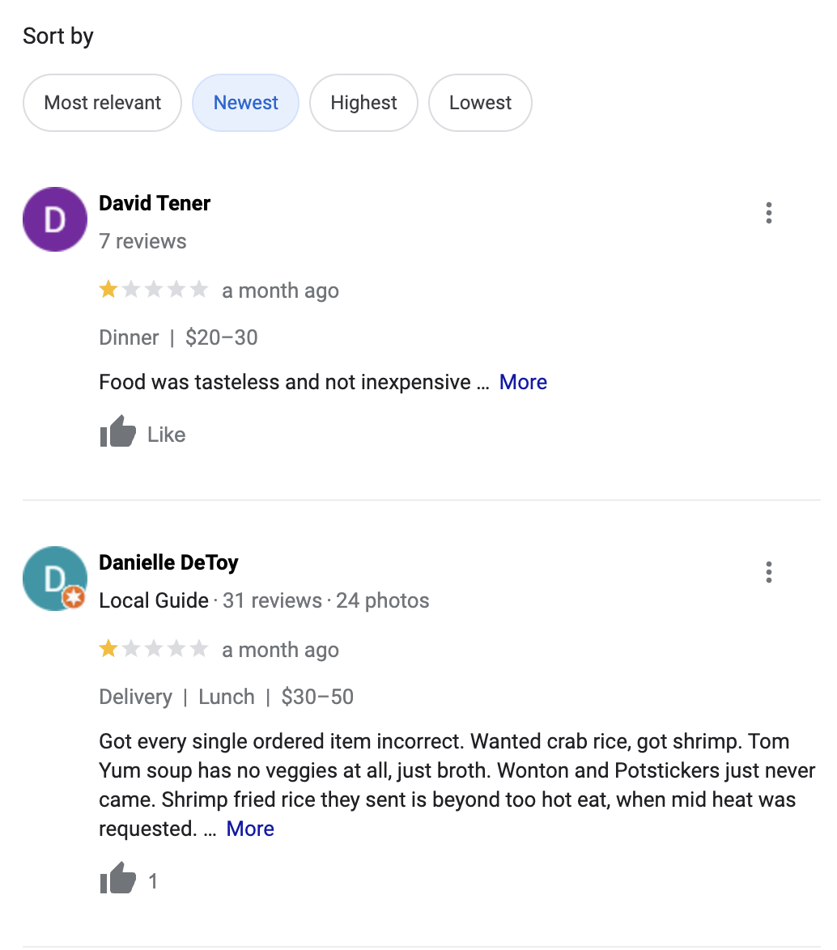
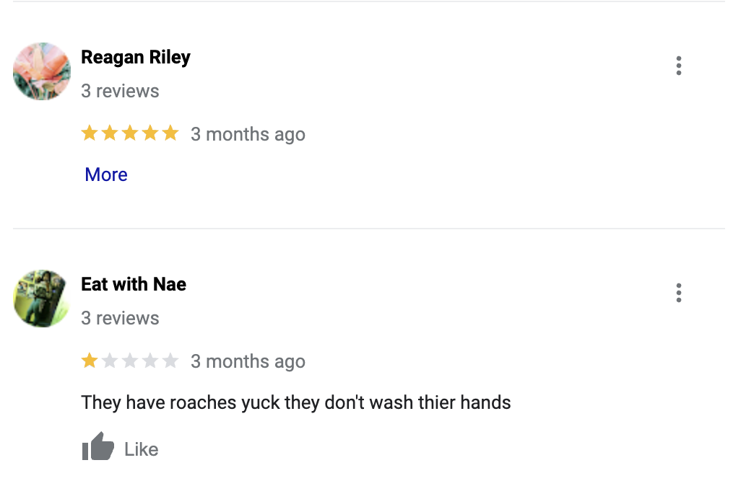
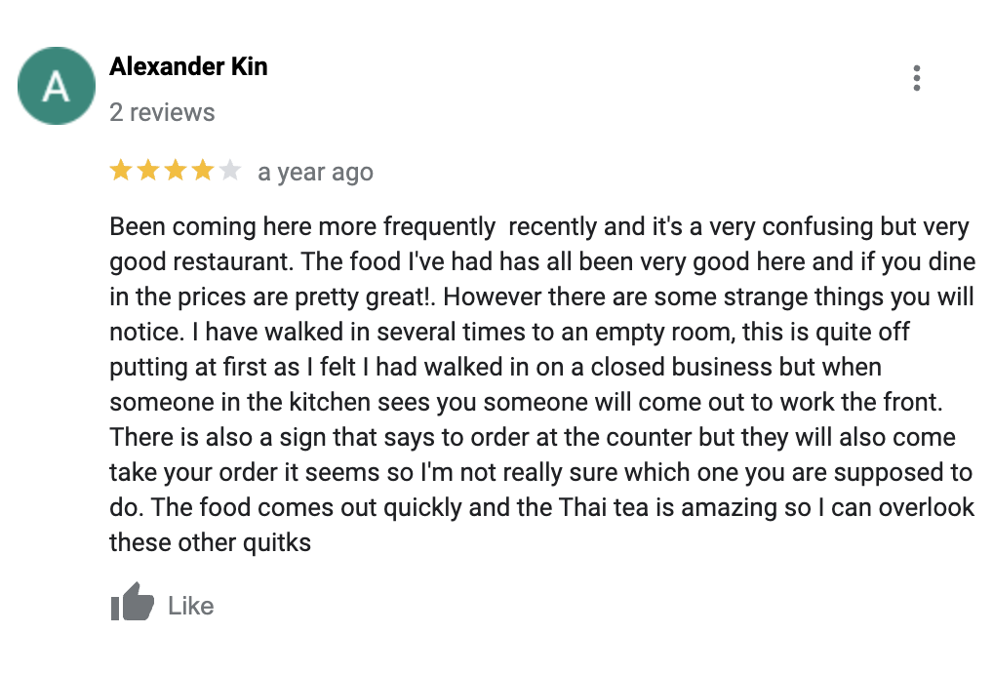
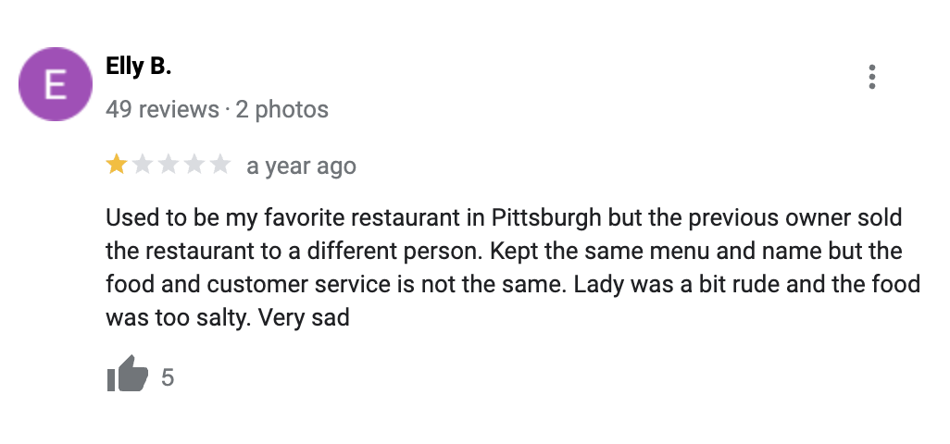
Rating Systems in Practice: Stale Ratings
Def: A Rating System aggregates reviews into a single, numeric measure of service provider quality.
Facilitates trust between a service provider and customer ^{[1]}
88% of customers investigate reviews before purchasing ^{[3]}
Def: We call a rating stale if it’s based off old transactions
38% of shoppers won’t purchase a product if the only reviews available are older than 90 days ^{[3]}
Key issue: Staling
Sequential Staling: Rating not determined by recent reviews
Ex.: By investigating, the truth is revealed
[1] S. Taledis, 2016. Reputation and Feedback Systems in Online Platform Markets.
[3] https://www.powerreviews.com/insights/information-shoppers-want-product-reviews/
[4] M. Luca, 2017. Designing Online Marketplaces: Trust and Reputation Mechanisms

Slide 8
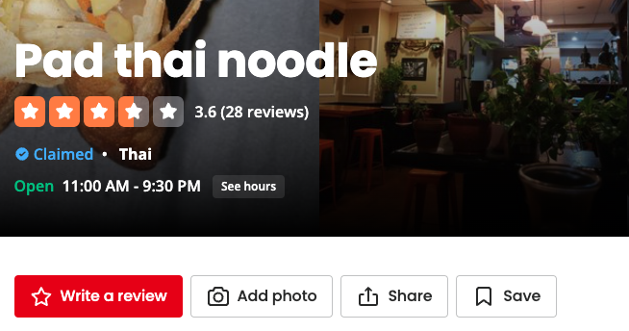
Rating Systems in Practice: Stale Ratings
Def: A Rating System aggregates reviews into a single, numeric measure of service provider quality.
Facilitates trust between a service provider and customer ^{[1]}
88% of customers investigate reviews before purchasing ^{[3]}
Def: We call a rating stale if it’s based off old transactions
38% of shoppers won’t purchase a product if the only reviews available are older than 90 days ^{[3]}
Key issue: Staling
Sequential Staling: Rating not determined by recent reviews
Temporal Staling: No recent reviews
Ex.: Fast forward one year later
[1] S. Taledis, 2016. Reputation and Feedback Systems in Online Platform Markets.
[3] https://www.powerreviews.com/insights/information-shoppers-want-product-reviews/
[4] M. Luca, 2017. Designing Online Marketplaces: Trust and Reputation Mechanisms

Slide 9
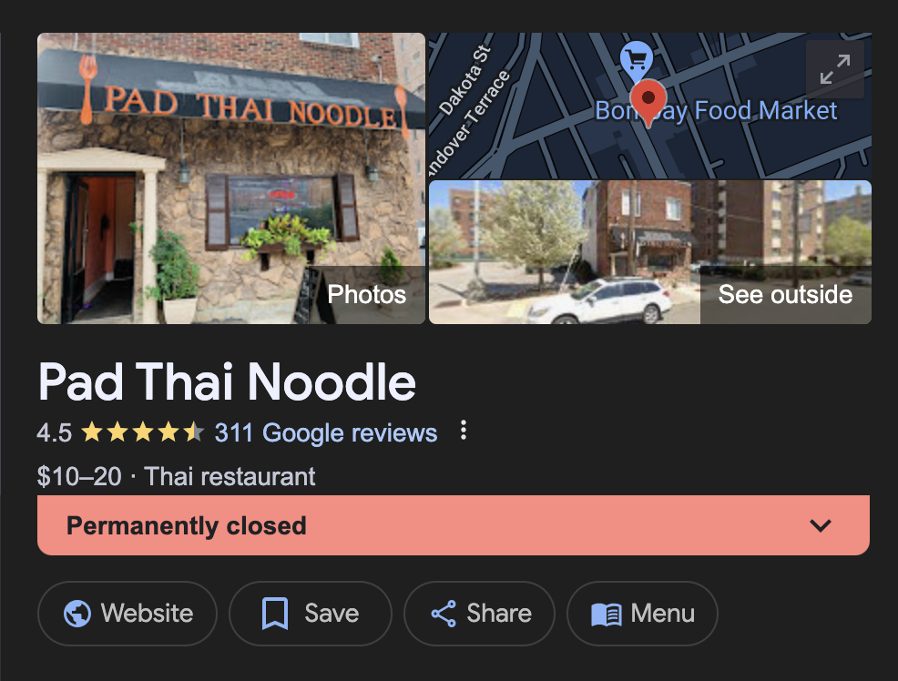
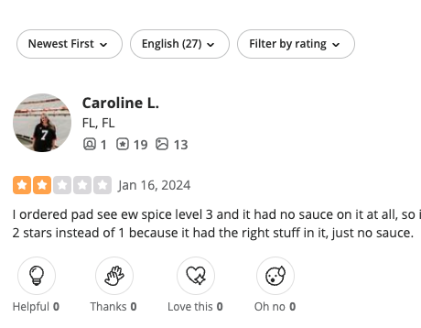
Rating Systems in Practice: Stale Ratings
Def: A Rating System aggregates reviews into a single, numeric measure of service provider quality.
Facilitates trust between a service provider and customer ^{[1]}
88% of customers investigate reviews before purchasing ^{[3]}
Def: We call a rating stale if it’s based off old transactions
38% of shoppers won’t purchase a product if the only reviews available are older than 90 days ^{[3]}
Key issue: Staling
Sequential Staling: Rating not determined by recent reviews
Temporal Staling: No recent reviews
Ex.: Finally accurate?
[1] S. Taledis, 2016. Reputation and Feedback Systems in Online Platform Markets.
[3] https://www.powerreviews.com/insights/information-shoppers-want-product-reviews/
[4] M. Luca, 2017. Designing Online Marketplaces: Trust and Reputation Mechanisms

Slide 10
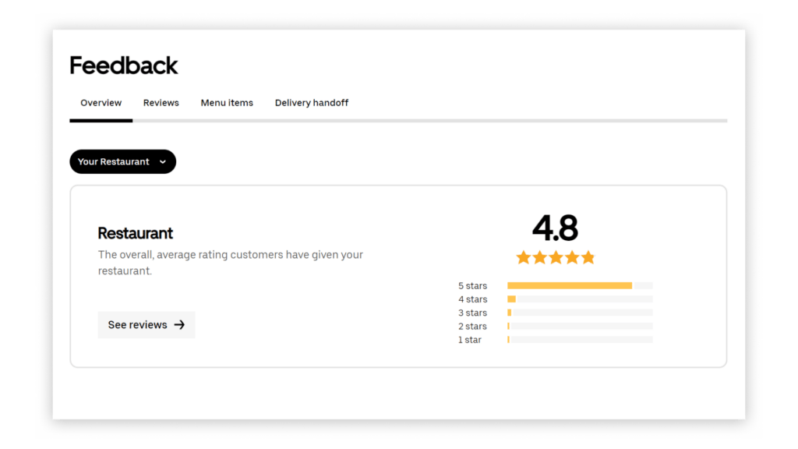



Rating Systems in Practice: Stale Ratings and Market Disintermediation
Def: A Rating System aggregates reviews into a single, numeric measure of service provider quality.
Facilitates trust between a service provider and customer
88% of customers investigate reviews before purchasing
Def: On a platform disintermediation occurs when users connect to services on the platform but transact off the platform.
As many as 90% of transactions can occur off platform for some industries ^{[5, 6]}
Key source of temporal staling we focus on in
Key issue: Staling
Sequential Staling: Rating not determined by recent reviews
Temporal Staling: No recent reviews
*
($$$)
[5] Sekar et al, 2023. Platform Disintermediation: Information Effects and Pricing Remedies
[6] Zhu, 2019. Why Some Platforms Thrive and Others Don’t
(*) UberEats uses a truncated window of the average of the last 100 reviews

Slide 11

Contributions
1. Consider how to change the structure of ratings to mitigate sequential staling
Introduce class of oblivious rating systems. Identify the ⍺-moving average rating system as asymptotically optimal rating system for mitigating issues due to sequential staling.
We compare the ⍺-moving average rating system with L-Sliding Windows. Prove moving average is a smooth version of the truncated windows^{[2,8]} systems with often superior protection.
2. Introduce penalty reviews to prevent temporal staling caused by disintermediation
Give a model of online platforms that facilitate interactions between service providers and customers and analyze how to set the penalty term and fee for a rating system.
We give a sharp condition for when the penalty and free mitigates temporal staling by encouraging service providers to continuously value new reviews.
We give a prior-free way of choosing the penalty and fee which guarantees ¾ of the optimal revenue.
(Full Paper)
[2] Mahfuze. 2023. Optimal Design of Ratings History
[7] Carnehl et al., 2023. Pricing for the stars: Dynamic pricing in the presence of rating systems
[8] Aperjis et al., 2010. Optimal Windows for Aggregating Ratings in Electronic Marketplaces

Slide 12
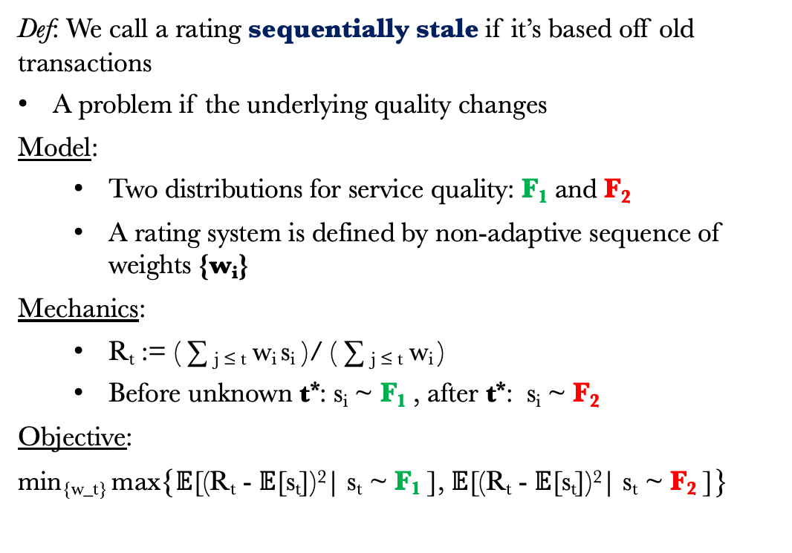
Rating System Design: Structure
Def: We call a rating sequentially stale if it’s based off old transactions
A problem if the underlying quality changes
Model:
Two distributions for service quality: F₁ and F₂
A rating system is defined by non-adaptive sequence of weights {w_{i}}
Mechanics:
R_{t} := ( ∑ _{j ≤ t} w_{i} s_{i} )/ ( ∑ _{j ≤ t} w_{i} )
Before unknown t*: s_{i} ~ F₁ , after t*: s_{i} ~ F₂
Objective:
min_{{w_t}} max{$𝔼$[(R_{t} - $𝔼$[s_{t}])²| s_{t} ~ F₁ ], $𝔼$[(R_{t} - $𝔼$[s_{t}])²| s_{t} ~ F₂ ]}
Qu: What kind of rating system stays fresh?
No Switch Error
Switch Error

Slide 13
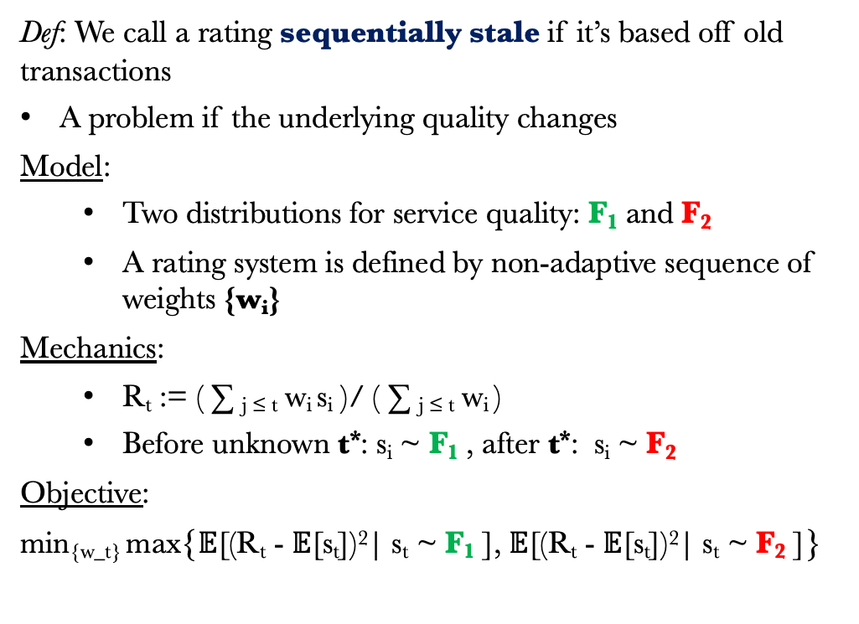
Rating System Design: Structure
Def: We call a rating sequentially stale if it’s based off old transactions
A problem if the underlying quality changes
Model:
Two distributions for service quality: F₁ and F₂
A rating system is defined by non-adaptive sequence of weights {w_{i}}
Mechanics:
R_{t} := ( ∑ _{j ≤ t} w_{i} s_{i} )/ ( ∑ _{j ≤ t} w_{i} )
Before unknown t*: s_{i} ~ F₁ , after t*: s_{i} ~ F₂
Objective:
min_{{w_t}} max{$𝔼$[(R_{t} - $𝔼$[s_{t}])²| s_{t} ~ F₁ ], $𝔼$[(R_{t} - $𝔼$[s_{t}])²| s_{t} ~ F₂ ]}
Qu: What kind of rating system stays fresh?
R₁ = w₁
s₁

Slide 14
Rating System Design: Structure
Def: We call a rating sequentially stale if it’s based off old transactions
A problem if the underlying quality changes
Model:
Two distributions for service quality: F₁ and F₂
A rating system is defined by non-adaptive sequence of weights {w_{i}}
Mechanics:
R_{t} := ( ∑ _{j ≤ t} w_{i} s_{i} )/ ( ∑ _{j ≤ t} w_{i} )
Before unknown t*: s_{i} ~ F₁ , after t*: s_{i} ~ F₂
Objective:
min_{{w_t}} max{$𝔼$[(R_{t} - $𝔼$[s_{t}])²| s_{t} ~ F₁ ], $𝔼$[(R_{t} - $𝔼$[s_{t}])²| s_{t} ~ F₂ ]}
Qu: What kind of rating system stays fresh?
R₁ = w₁s₁ /w₁
R₂ = w₁s₁ + w₂
s₂

Slide 15
Rating System Design: Structure
Def: We call a rating sequentially stale if it’s based off old transactions
A problem if the underlying quality changes
Model:
Two distributions for service quality: F₁ and F₂
A rating system is defined by non-adaptive sequence of weights {w_{i}}
Mechanics:
R_{t} := ( ∑ _{j ≤ t} w_{i} s_{i} )/ ( ∑ _{j ≤ t} w_{i} )
Before unknown t*: s_{i} ~ F₁ , after t*: s_{i} ~ F₂
Objective:
min_{{w_t}} max{$𝔼$[(R_{t} - $𝔼$[s_{t}])²| s_{t} ~ F₁ ], $𝔼$[(R_{t} - $𝔼$[s_{t}])²| s_{t} ~ F₂ ]}
Qu: What kind of rating system stays fresh?
R₁ = w₁s₁ /w₁
R₂ = (w₁s₁ + w₂ s₂)/(w₁ + w₂)

Slide 16


Rating System Design: Structure
Def: We call a rating sequentially stale if it’s based off old transactions
A problem if the underlying quality changes
Model:
Two distributions for service quality: F₁ and F₂
A rating system is defined by non-adaptive sequence of weights {w_{i}}
Mechanics:
R_{t} := ( ∑ _{j ≤ t} w_{i} s_{i} )/ ( ∑ _{j ≤ t} w_{i} )
Before unknown t*: s_{i} ~ F₁ , after t*: s_{i} ~ F₂
Objective:
min_{{w_t}} max{$𝔼$[(R_{t} - $𝔼$[s_{t}])²| s_{t} ~ F₁ ], $𝔼$[(R_{t} - $𝔼$[s_{t}])²| s_{t} ~ F₂ ]}
Qu: What kind of rating system stays fresh?
R₁ = w₁s₁ /w₁
R₂ = (w₁s₁ + w₂ s₂)/(w₁ + w₂)
R₃ = w₁s₁ + w₂ s₂ + w₃
s₃

Slide 17
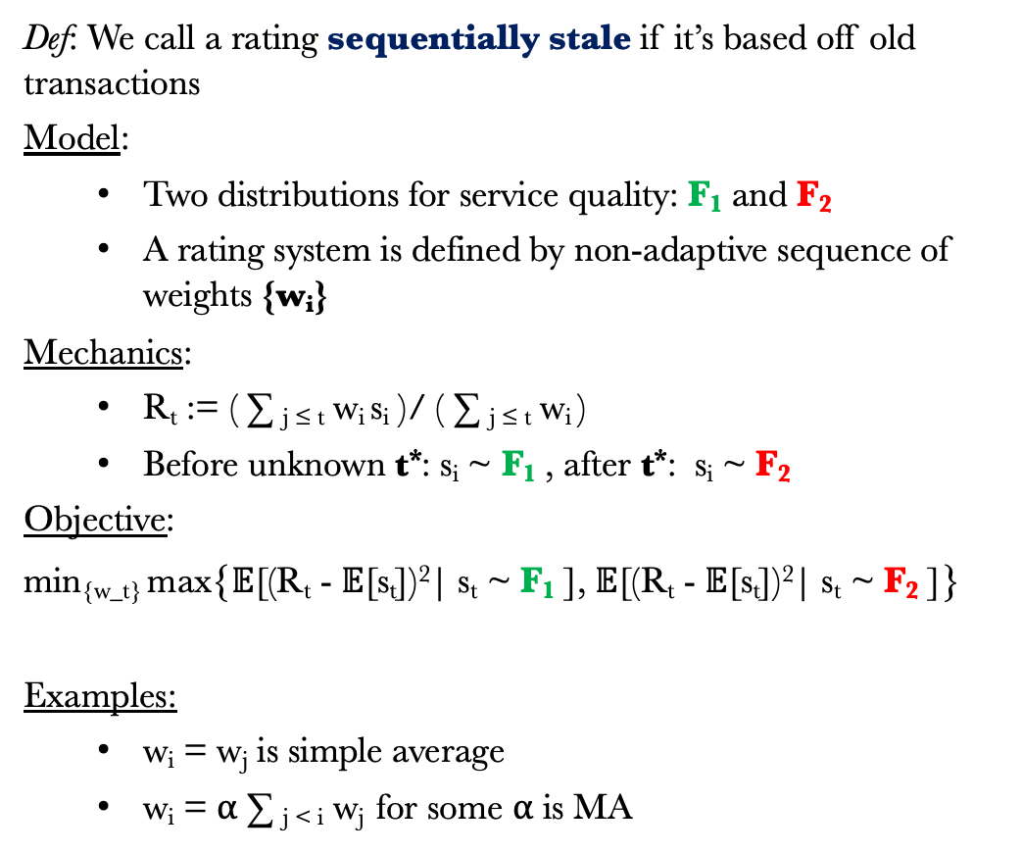
Rating System Design: Structure
Def: We call a rating sequentially stale if it’s based off old transactions
Model:
Two distributions for service quality: F₁ and F₂
A rating system is defined by non-adaptive sequence of weights {w_{i}}
Mechanics:
R_{t} := ( ∑ _{j ≤ t} w_{i} s_{i} )/ ( ∑ _{j ≤ t} w_{i} )
Before unknown t*: s_{i} ~ F₁ , after t*: s_{i} ~ F₂
Objective:
min_{{w_t}} max{$𝔼$[(R_{t} - $𝔼$[s_{t}])²| s_{t} ~ F₁ ], $𝔼$[(R_{t} - $𝔼$[s_{t}])²| s_{t} ~ F₂ ]}
Examples:
w_{i} = w_{j} is simple average
w_{i} = ⍺ ∑ _{j < i} w_{j} for some ⍺ is MA
Qu: What kind of rating system stays fresh?
Simple average becomes stale
R₁ = w₁s₁ /w₁
R₂ = (w₁s₁ + w₂ s₂)/(w₁ + w₂)
R₃ = (w₁s₁ + w₂ s₂ + w₃ s₃)/(w₁ + w₂ + w₃)

Slide 18
Rating System Design: Structure
Def. An oblivious rating system is one such that there exists a fixed sequence {w_{i}} to describe it
Theorem 1 [MA Ratings are Min-Max Optimal].
For any positive valued distributions F₁ and F₂ where the service quality switches adversarially, the oblivious weights that myopically minimizes the maximum MSE at each time step always converges to either a moving average or a simple average rating system.
Remarks
The weights are chosen to minimize the max of Switching and No Switching Error at each time step
When F₁ and F₂ are very similar, simple average is optimal
When F₁ and F₂ are different, a moving average system is asymptotically optimal for some ⍺ = lim w_{i} /(∑ _{j < i} w_{j})
This model set-up is like a non-adaptive version of change point detection ^{[9,10]}
[9] Lowry et al., 1995. A review of multivariate control charts
[10] Aminikhanghahi et al., 2017. survey of methods for time series change point detection

Slide 19
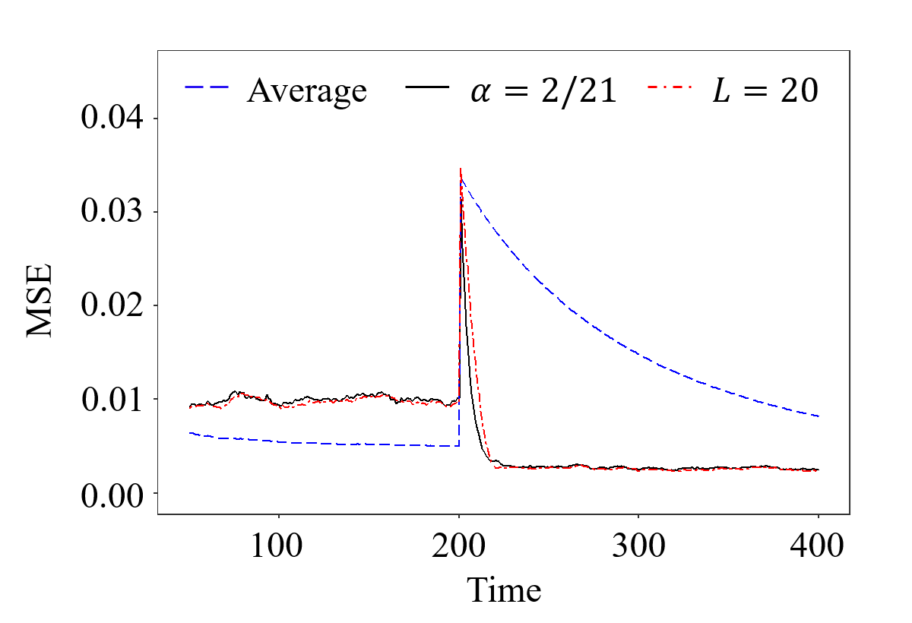
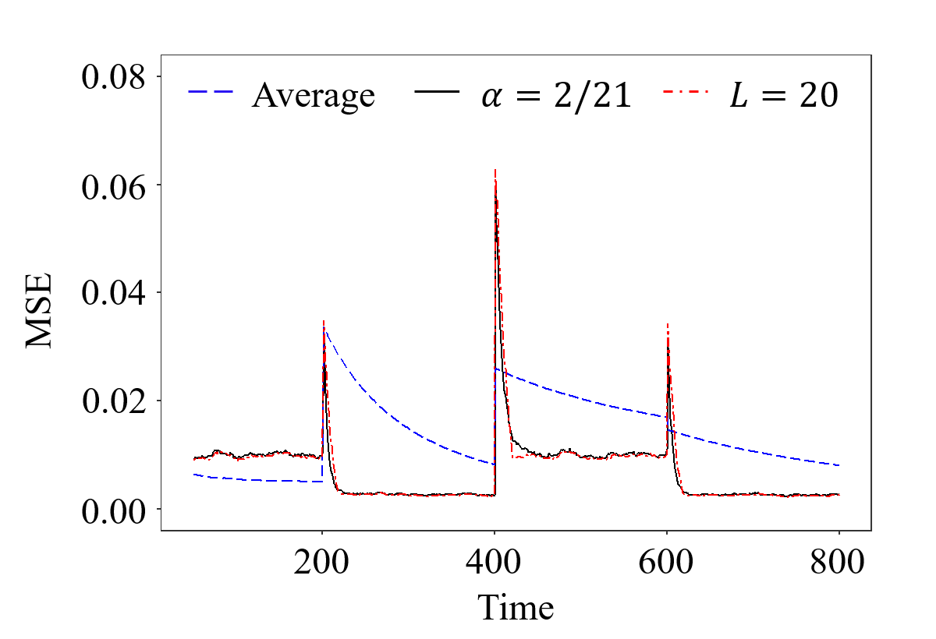
Rating System Design: Structure
Def. An oblivious rating system is one such that there exists a fixed sequence {w_{i}} to describe it
Theorem 1 [MA Ratings are Min-Max Optimal].
For any positive valued distributions F₁ and F₂ where the service quality switches adversarially, the oblivious weights that myopically minimizes the maximum MSE at each time step always converges to either a moving average or a simple average rating system.
Example:
F₁ = Exp(2),
F₂ = Exp(4)

Slide 20
Rating System Design: Incentives and Fees
Def: On a platform disintermediation is when users connect to services on the platform but transact off the platform.
Major cause of temporal staling where no review is new
Model:
Service providers have true quality q ~ G
Service providers disintermediate with rate p
Users contract with provider with probability: h(R_{t})
R_{t} = (1-⍺)R_{t-1} + ⍺ g(s_{t} or NR), g(s_{t}) = s_{t}, g(NR) = β
Mechanics:
If contracted with prob. h(R_{t})
Either transact on platform, pay fee f and get rating
Or transact off platform, no fee and penalty rating
Stackelberg game: First choose f, β then choose p
Objective: Maximize expected long-run platform revenue
Qu: What kind of rating system stops disintermediation?
Must transact on platform to leave review
If rating is high, why solicit more?

Slide 21
Rating System Design: Incentives and Fees
Def: On a platform disintermediation is when users connect to services on the platform but transact off the platform.
Major cause of temporal staling where no review is new
Model:
Service providers have true quality q ~ G
Service providers disintermediate with rate p
Users contract with provider with probability: h(R_{t})
R_{t} = (1-⍺)R_{t-1} + ⍺ g(s_{t} or NR), g(s_{t}) = s_{t}, g(NR) = β
Mechanics:
If contracted with prob. h(R_{t})
Either transact on platform, pay fee f and get rating
Or transact off platform, no fee and penalty rating
Stackelberg game: First choose f, β then choose p
Objective: Maximize expected long-run platform revenue
Qu: What kind of rating system stops disintermediation?
Must transact on platform to leave review
⍺ = .1, β = .5
E[R_{t}] = .8

Slide 22
Rating System Design: Incentives and Fees
Def: On a platform disintermediation is when users connect to services on the platform but transact off the platform.
Major cause of temporal staling where no review is new
Model:
Service providers have true quality q ~ G
Service providers disintermediate with rate p
Users contract with provider with probability: h(R_{t})
R_{t} = (1-⍺)R_{t-1} + ⍺ g(s_{t} or NR), g(s_{t}) = s_{t}, g(NR) = β
Mechanics:
If contracted with prob. h(R_{t})
Either transact on platform, pay fee f and get rating
Or transact off platform, no fee and penalty rating
Stackelberg game: First choose f, β then choose p
Objective: Maximize expected long-run platform revenue
Qu: What kind of rating system stops disintermediation?
Must transact on platform to leave review
⍺ = .1, β = .5
E[R_{t}] = .8
f, q

Slide 23
Rating System Design: Incentives and Fees
Def: On a platform disintermediation is when users connect to services on the platform but transact off the platform.
Major cause of temporal staling where no review is new
Model:
Service providers have true quality q ~ G
Service providers disintermediate with rate p
Users contract with provider with probability: h(R_{t})
R_{t} = (1-⍺)R_{t-1} + ⍺ g(s_{t} or NR), g(s_{t}) = s_{t}, g(NR) = β
Mechanics:
If contracted with prob. h(R_{t})
Either transact on platform, pay fee f and get rating
Or transact off platform, no fee and penalty rating
Stackelberg game: First choose f, β then choose p
Objective: Maximize expected long-run platform revenue
Qu: What kind of rating system stops disintermediation?
Must transact on platform to leave review
⍺ = .1, β = .5
E[R_{t+1}] = .9(.8) + .1 q

Slide 24
Rating System Design: Incentives and Fees
Def: On a platform disintermediation is when users connect to services on the platform but transact off the platform.
Major cause of temporal staling where no review is new
Model:
Service providers have true quality q ~ G
Service providers disintermediate with rate p
Users contract with provider with probability: h(R_{t})
R_{t} = (1-⍺)R_{t-1} + ⍺ g(s_{t} or NR), g(s_{t}) = s_{t}, g(NR) = β
Mechanics:
If contracted with prob. h(R_{t})
Either transact on platform, pay fee f and get rating
Or transact off platform, no fee and penalty rating
Stackelberg game: First choose f, β then choose p
Objective: Maximize expected long-run platform revenue
Qu: What kind of rating system stops disintermediation?
Must transact on platform to leave review
⍺ = .1, β = .5
E[R_{t+1}] = .82

Slide 25
Rating System Design: Incentives and Fees
Def: On a platform disintermediation is when users connect to services on the platform but transact off the platform.
Major cause of temporal staling where no review is new
Model:
Service providers have true quality q ~ G
Service providers disintermediate with rate p
Users contract with provider with probability: h(R_{t})
R_{t} = (1-⍺)R_{t-1} + ⍺ g(s_{t} or NR), g(s_{t}) = s_{t}, g(NR) = β
Mechanics:
If contracted with prob. h(R_{t})
Either transact on platform, pay fee f and get rating
Or transact off platform, no fee and penalty rating
Stackelberg game: First choose f, β then choose p
Objective: Maximize expected long-run platform revenue
Qu: What kind of rating system stops disintermediation?
Must transact on platform to leave review
⍺ = .1, β = .5
E[R_{t+1}] = .82
($$$)

Slide 26
Rating System Design: Incentives and Fees
Def: On a platform disintermediation is when users connect to services on the platform but transact off the platform.
Major cause of temporal staling where no review is new
Model:
Service providers have true quality q ~ G
Service providers disintermediate with rate p
Users contract with provider with probability: h(R_{t})
R_{t} = (1-⍺)R_{t-1} + ⍺ g(s_{t} or NR), g(s_{t}) = s_{t}, g(NR) = β
Mechanics:
If contracted with prob. h(R_{t})
Either transact on platform, pay fee f and get rating
Or transact off platform, no fee and penalty rating
Stackelberg game: First choose f, β then choose p
Objective: Maximize expected long-run platform revenue
Qu: What kind of rating system stops disintermediation?
Must transact on platform to leave review
⍺ = .1, β = .5
E[R_{t+1}] = .9(.82)+.1(.5)

Slide 27
Rating System Design: Incentives and Fees
Def: On a platform disintermediation is when users connect to services on the platform but transact off the platform.
Major cause of temporal staling where no review is new
Model:
Service providers have true quality q ~ G
Service providers disintermediate with rate p
Users contract with provider with probability: h(R_{t})
R_{t} = (1-⍺)R_{t-1} + ⍺ g(s_{t} or NR), g(s_{t}) = s_{t}, g(NR) = β
Mechanics:
If contracted with prob. h(R_{t})
Either transact on platform, pay fee f and get rating
Or transact off platform, no fee and penalty rating
Stackelberg game: First choose f, β then choose p
Objective: Maximize expected long-run platform revenue
Qu: What kind of rating system stops disintermediation?
Must transact on platform to leave review
⍺ = .1, β = .5
E[R_{t+2}] = .788

Slide 28
Rating System Design: Incentives and Fees
Def: On a platform disintermediation is when users connect to services on the platform but transact off the platform.
Major cause of temporal staling where no review is new
Model:
Service providers have true quality q ~ G
Service providers disintermediate with rate p
Users contract with provider with probability: h(R_{t})
R_{t} = (1-⍺)R_{t-1} + ⍺ g(s_{t} or NR), g(s_{t}) = s_{t}, g(NR) = β
Mechanics:
If contracted with prob. h(R_{t})
Either transact on platform, pay fee f and get rating
Or transact off platform, no fee and penalty rating
Stackelberg game: First choose f, β then choose p
Objective: Maximize expected long-run platform revenue
Qu: What kind of rating system stops disintermediation?
Must transact on platform to leave review
⍺ = .1, β = .5
E[R_{t+2}] = .9(.78)+.1(.5)

Slide 29
Rating System Design: Incentives and Fees
Def: On a platform disintermediation is when users connect to services on the platform but transact off the platform.
Major cause of temporal staling where no review is new
Model:
Service providers have true quality q ~ G
Service providers disintermediate with rate p
Users contract with provider with probability: h(R_{t})
R_{t} = (1-⍺)R_{t-1} + ⍺ g(s_{t} or NR), g(s_{t}) = s_{t}, g(NR) = β
Mechanics:
If contracted with prob. h(R_{t})
Either transact on platform, pay fee f and get rating
Or transact off platform, no fee and penalty rating
Stackelberg game: First choose f, β then choose p
Objective: Maximize expected long-run platform revenue
Qu: What kind of rating system stops disintermediation?
Must transact on platform to leave review
⍺ = .1, β = .5
E[R_{t+2}] = .76

Slide 30
Rating System Design: Incentives and Fees
Def: On a platform disintermediation is when users connect to services on the platform but transact off the platform.
Major cause of temporal staling where no review is new
Model:
Service providers have true quality q ~ G
Service providers disintermediate with rate p
Users contract with provider with probability: h(R_{t})
R_{t} = (1-⍺)R_{t-1} + ⍺ g(s_{t} or NR), g(s_{t}) = s_{t}, g(NR) = β
Mechanics:
If contracted with prob. h(R_{t})
Either transact on platform, pay fee f and get rating
Or transact off platform, no fee and penalty rating
Stackelberg game: First choose f, β then choose p
Objective: Maximize expected long-run platform revenue
Qu: What kind of rating system stops disintermediation?
Must transact on platform to leave review
⍺ = .1, β = .5
E[R_{t+3}] = .9(.76) + .1(?)

Slide 31
Rating System Design: Incentives and Fees
Set-up: Service providers on the platform choose a rate at which to disintermediate, p
Lemma 2 [Disincentives Disintermediation].
For fixed (β, f), when the probability of being hired is linear in R_{t} , providers with quality q such that q < β + f eventually always disintermediate, otherwise they never disintermediate.
Remarks
Intuition: If you are punished via your rating, but your rating would never be good anyway, then it will not be an effective incentive tool
Intuition: If you are punished via your rating, but your rating would be good, then to protect your rating you will want to transact on platform
Fixing (β, f) determines a minimum service level for the platform
Common on major service platforms. Uber requires a 4.6 rating to drive

Slide 32
Rating System Design: Incentives and Fees
Set-up: The platform needs to choose a fee per transaction f, and “no-show” rating g(NR) = β
Theorem 3 [Approximately Optimal Rating Design].
For any level of minimum service level c, and any distribution of quality G supported on (c,1], when the probability of being hired is proportional to R_{t} , choosing:
(β, f) = ( (1 – (1 – c)^{1/2} + c)/2 , ((1 – c)^{1/2} - 1 + c)/2 )
gives a 3/4 approximation of the long-run optimal achievable revenue for the platform.
Remarks
The minimum service quality is a constraint: c = β + f
Intuition: Intermediate value of β makes it punishing to transact off the platform, but not as punishing as providing poor service
Optimal policy depends on distribution, ¾ approximation is distribution agnostic
Guarantee is tight

Slide 33
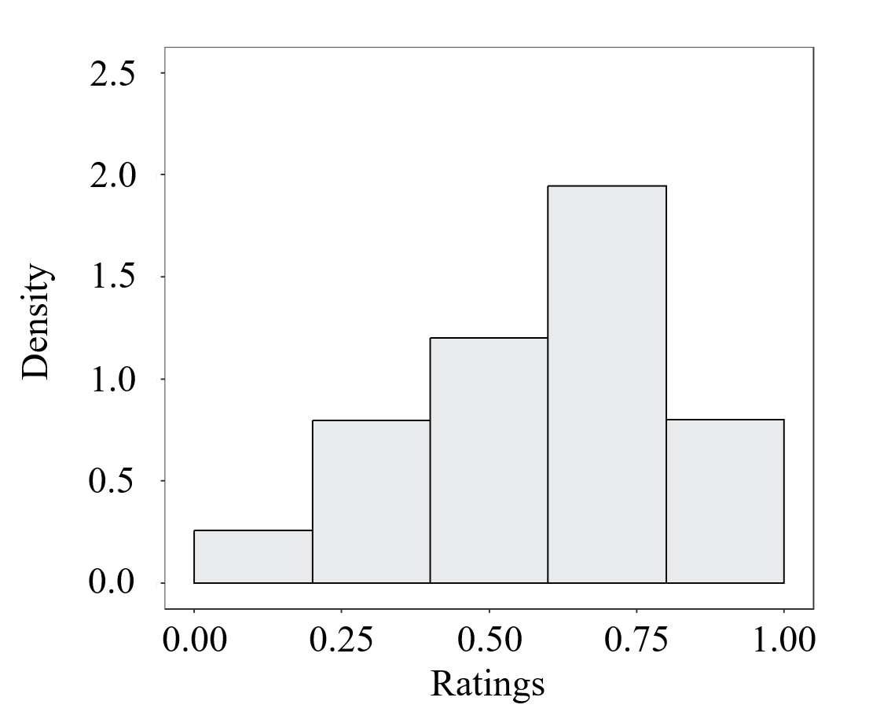
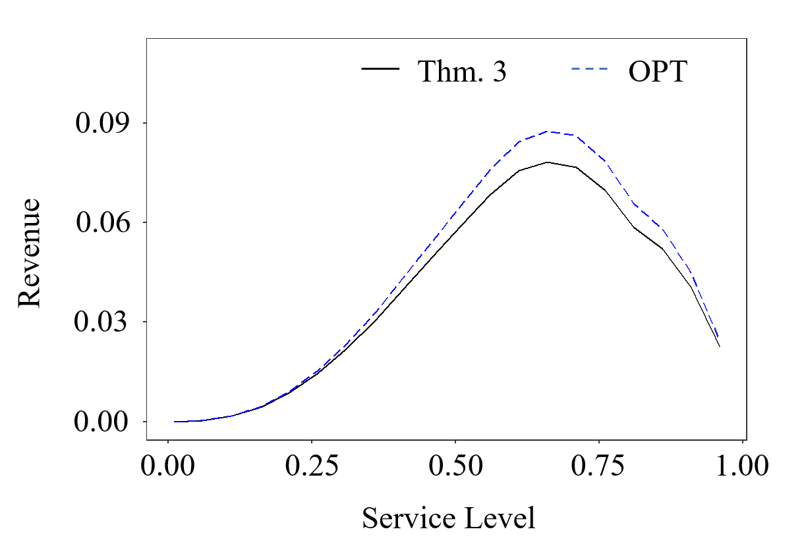
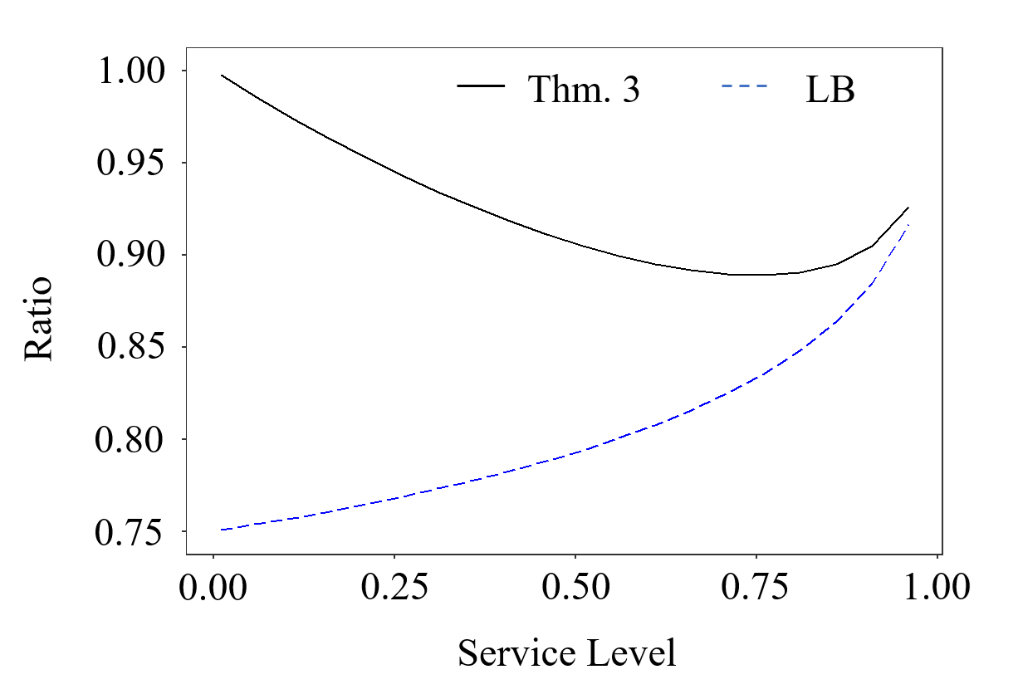
Rating System Design: Incentives and Fees
Set-up: The platform needs to choose a fee per transaction f, and “no-show” rating g(NR) = β
Theorem 3 [Approximately Optimal Rating Design].
For any level of minimum service quality c, and any distribution of quality F supported on (c,1], when the probability of being hired is proportional to R_{t} , choosing:
(β, f) = ( (1 – (1 – c)^{1/2} + c)/2 , ((1 – c)^{1/2} - 1 + c)/2 )
gives a 3/4 approximation of the long-run optimal achievable revenue for the platform.

Slide 34
Conclusions
C1. Introduced a moving average inspired rating system to address sequential staling
Introduced a framework for oblivious rating system facing adversarial change in service quality
The parameter ⍺ can be tuned to trade-off change point detection and rating sensitivity
This is asymptotically optimal for a min-max objective that protects customers from worst case outcomes
C2. Introduce penalty reviews to address temporal staling caused by disintermediation
By down-weighting ratings due to perceived inactivity the platform can prevent disintermediation
The penalty term β can be tuned to penalize inactivity, incentivizing high quality service providers to transact on the platform and generating revenue
We give theory for setting β and the fee f that is detail-free and approximately optimal

Slide 35

Thank You!
Full paper on SSRN: Fresh Rating Systems: Structure, Incentives, and Fees
Comments, questions, and suggestions are very welcome!
If you like this work, Titing Cui is joining the University of Tulsa
More of his work at: https://tcui-pitt.github.io/
You can find these slides at: https://mhamilton-pitt.github.io/publications/
Contact: tic54@pitt.edu , mhamilton@katz.pitt.edu

